Slide 1
Scheduling policies

Slide 2
Scheduling Criteria
CPU-bound processes
Use all available processor time
I/O-bound
Generates an I/O request quickly and relinquishes processor
Batch processes
Contains work to be performed with no user interaction
Interactive processes
Requires frequent user input

Slide 3
Scheduling Criteria
CPU utilization – keep the CPU as busy as possible
Throughput – # of processes that complete their execution per time unit
Turnaround time – amount of time to execute a particular process
Waiting time – amount of time a process has been waiting in the ready queue and blocked queue
Response time – amount of time it takes from when a request was submitted until the first response is produced, not output (for time-sharing environment)

Slide 4
Optimization Criteria
Max throughput
Jobs per second
Throughput related to response time, but not identical
Minimizing response time will lead to more context switching than if you maximized only throughput
Minimize overhead (context switch time) as well as efficient use of resources (CPU, disk, memory, etc.)
Min response time
Elapsed time to do an operation (job)
Response time is what the user sees
Time to echo keystroke in editor
Time to compile a program
Real-time Tasks: Must meet deadlines imposed by World

Slide 5
Min turnaround time
Min waiting time
Max CPU utilization
Fairness
Share CPU among users in some equitable way
Not just minimizing average response time

Slide 6
Selection Function
Determines which process is selected for execution.
If it is based on execution characteristics then important quantities are:
w = time spent in system so far, waiting
e = time spent in execution so far
s = total service time required by the process, including e

Slide 7
Decision Mode
Specifies the instants in time at which the selection function is exercised.
Two categories:
Non-preemptive
Preemptive

Slide 8
Non-preemptive vs Preemptive
Non-preemptive
Once a process is in the running state, it will continue until it terminates or blocks itself for I/O or OS service.
i.e. Run until completion or until they yield control of a processor
Unimportant processes can block important ones indefinitely
Preemptive
Currently running process may be interrupted and moved to ready state by the OS.
Preemption may occur when new process arrives, on an interrupt, or periodically.
Can be removed from their current processor
Can lead to improved response times
Important for interactive environments
Preempted processes remain in memory

Slide 9
Priorities
Static priorities
Priority assigned to a process does not change
Easy to implement
Low overhead
Not responsive to changes in environment
Dynamic priorities
Responsive to change
Promote smooth interactivity
Incur more overhead than static priorities
Justified by increased responsiveness

Slide 10
Scheduling Objectives
Different objectives depending on system
Maximize throughput
Maximize number of interactive processes receiving acceptable response times
Minimize resource utilization
Avoid indefinite postponement
Enforce priorities
Minimize overhead
Ensure predictability

Slide 11
Scheduling Objectives
Several goals common to most schedulers
Fairness
Predictability
Scalability

Slide 12
Scheduling Algorithms
Scheduling algorithms
Decide when and for how long each process runs
Make choices about
Preemptibility
Priority
Running time
Run-time-to-completion
fairness

Slide 13
First-In-First-Out (FIFO)/ First Come First Serve (FCFS) Scheduling
Simplest scheme: Jobs are executed on first come, first serve basis
Processes dispatched according to arrival time
It is a non-preemptive scheduling algorithm.
Easy to understand and implement.
Its implementation is based on FIFO queue
Poor in performance as average wait time is high
Rarely used as primary scheduling algorithm
Convoy effect

Slide 14
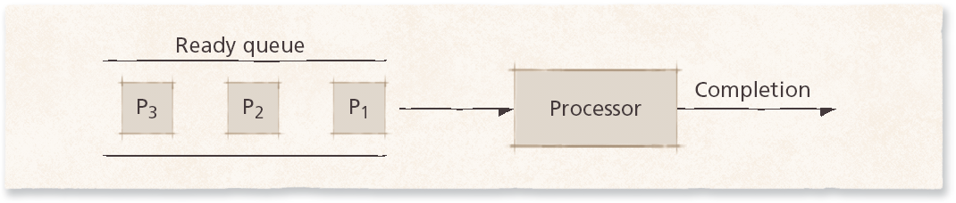
First-In-First-Out (FIFO) Scheduling

Slide 15
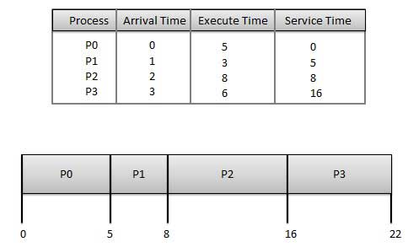
First Come First Serve (FCFS)

Slide 16
Turnaround time of each process is as follows −
Process | Turnaround Time
P0 | 5 - 0 = 5
P1 | 8 - 1 = 7
P2 | 16 - 2 = 14
P3 | 22 - 3 = 19
Average Turnaround Time: (5+7+14+19) / 4 = 11.25

Slide 17
Wait time of each process is as follows −
Process | Wait Time
P0 | 0 - 0 = 0
P1 | 5 - 1 = 4
P2 | 8 - 2 = 6
P3 | 16 - 3 = 13
Average Wait Time: (0+4+6+13) / 4 = 5.75

Slide 18
Round-Robin (RR) Scheduling
Round-robin scheduling
Based on FIFO
Processes run only for a limited amount of time called a time slice or quantum
Preemptible
Requires the system to maintain several processes in memory to minimize overhead
Context switching is used to save states of preempted processes.
Often used as part of more complex algorithms

Slide 19
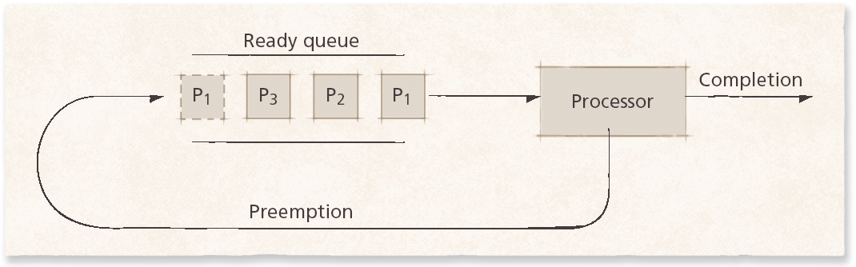
Round-Robin (RR) Scheduling

Slide 20
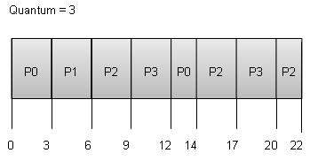
Assumption at time = 3, P3 is first put in the ready queue then P0.

Slide 21
Turnaround time of each process is as follows :
Process | Turnaround Time
P0 | 14-0 = 14
P1 | 6 -1 =5
P2 | 22-2 = 20
P3 | 20 – 3 = 17
Average Turnaround Time: (14 + 5 +20 + 17) / 4 = 14

Slide 22
Wait time of each process is as follows
Process | Wait Time
P0 | (0 - 0) + (12 - 3) = 9
P1 | (3 - 1) = 2
P2 | (6 - 2) + (14 - 9) + (20 - 17) = 12
P3 | (9 - 3) + (17 - 12) = 11
Average Wait Time: (9+2+12+11) / 4 = 8.5

Slide 23
Round-Robin (RR) Scheduling
Variants of RR:
State dependent RR: same as RR but Q is varied dynamically depending on the state of the system.
External priorities/ Weighted RR: RR but a user can pay more and get bigger Q.
Selfish RR:
A new process starts at priority 0; its priority increases at rate a>=0. It becomes an accepted process when its priority reaches that of an accepted process (or until there are no accepted processes). At any time all accepted processes have same priority.
Increases priority as process ages
Two queues
Active
Holding
Favors older processes to avoids unreasonable delays

Slide 24
Round-Robin (RR) Scheduling
Quantum size
Determines response time to interactive requests
Very large quantum size
Processes run for long periods
Degenerates to FIFO
Very small quantum size
System spends more time context switching than running processes
Middle-ground
Long enough for interactive processes to issue I/O request
Batch processes still get majority of processor time

Slide 25
Shortest-Process-First/Next (SPF/N) / Shortest Job First (SJF) Scheduling
Scheduler selects process with smallest time to finish
Lower average wait time than FIFO
Reduces the number of waiting processes
Potentially large variance in wait times
Non-preemptive
Results in slow response times to arriving interactive requests
Best approach to minimize waiting time.
Relies on estimates of time-to-completion
Can be inaccurate or falsified
Easy to implement in Batch systems where required CPU time is known in advance.
Impossible to implement in interactive systems where required CPU time is not known. The processer should know in advance how much time process will take.
Unsuitable for use in modern interactive systems

Slide 26
Shortest Job First
Process | Arrival Time | Execute Time
P0 | 0 | 5
P1 | 0 | 3
P2 | 0 | 8
P3 | 0 | 6

Slide 27
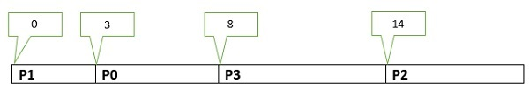
Gantt Chart
When arrival time of all processes is zero

Slide 28
Turnaround Time of each process is as follows:
Process | Turnaround Time
P0 | 8
P1 | 3
P2 | 22
P3 | 14
Average Turnaround Time: (8+3+22+14) / 4 = 11.75

Slide 29
Wait Time of each process is as follows:
Process | Wait Time
P0 | 3
P1 | 0
P2 | 14
P3 | 8
Average Wait Time: (3+14+8) / 4 = 6.25

Slide 30
Shortest-Remaining-Time (SRT) Scheduling
SRT scheduling
Preemptive version of SPF
Shorter arriving processes preempt a running process
Very large variance of response times: long processes wait even longer than under SPF
Not always optimal
Short incoming process can preempt a running process that is near completion
Context-switching overhead can become significant

Slide 31
Shortest Remaining Time
Process | Arrival Time | Execute Time
P0 | 0 | 5
P1 | 1 | 3
P2 | 2 | 8
P3 | 3 | 6

Slide 32
P0 | P1 | P0 | P3 | P2
0 1 4 8 14 22

Slide 33
Turnaround Time of each process is as follows:
Process | Turnaround Time
P0 | 8-0 = 8
P1 | 4-1 = 3
P2 | 22-2 =20
P3 | 14-3 = 11
Average Turnaround Time: (8+3+20+11) / 4 = 10.5

Slide 34
Wait Time of each process is as follows:
Process | Wait Time
P0 | 4-1 =3
P1 | 0
P2 | 14-2 =12
P3 | 8-3 =5
Average Wait Time: (3+12+5) / 4 = 5

Slide 35
Highest-Response-Ratio-Next (HRRN) Scheduling
The discrimination towards long jobs in SJF is reduced by the strategy HRRN. Response ratio is the sum of wait time and Job time divided by the Job time. The job with the highest response time is chosen for scheduling. To start with long jobs suffer but as their wait time increases the response time ratio also increases.
HRRN scheduling
Improves upon SPF scheduling
Still nonpreemptive
Considers how long process has been waiting
Prevents indefinite postponement

Slide 36
Process ID | Arrival Time | Burst Time
0 | 0 | 3
1 | 2 | 5
2 | 4 | 4
3 | 6 | 1
4 | 8 | 2

Slide 37
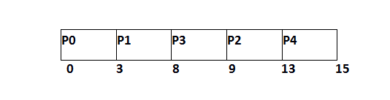
P0 is executed for 3 units
P3 is scheduled for 1 unit.
P1 is executed for 5 units
RR ( P2) = (5+4)/4 = 2.25
RR (P4) = (1+2)/2 = 1.5
RR (P2) = ((8-4) +4)/4 = 2
RR (P3) = (2+1)/1 = 3
RR (P4) = (0+2)/2 = 1
P2 will be scheduled, P4 will be scheduled
Notes:
Response Ratio = (W + S)/S
Here, W is the waiting time of the process so far and S is the Burst time of the process.

Slide 38
Priority Based Scheduling
Priority scheduling is a non-preemptive algorithm and one of the most common scheduling algorithms in batch systems.
Each process is assigned a priority. Process with highest priority is to be executed first and so on.
Processes with same priority are executed on first come first served basis.
Priority can be decided based on memory requirements, time requirements or any other resource requirement.

Slide 39
Priority Scheduling
Ready queue is maintained in priority order, where priority of a process is:
determined by OS (e.g., run system processes before user processes use the CPU, average time of last CPU bursts, number of open files, memory size etc. )
purchased by user
based on corporate policy (e.g. give high priority to some project viewed as very important to company)

Slide 40
Process | Arrival Time | Execute Time | Priority
P0 | 0 | 5 | 1
P1 | 0 | 3 | 2
P2 | 0 | 8 | 1
P3 | 0 | 6 | 3

Slide 41
P3 | P1 | P0 | P2
0 6 9 14 22

Slide 42
Turnaround Time of each process is as follows:
Process | Turnaround Time
P0 | 14
P1 | 9
P2 | 22
P3 | 6
Average Turnaround Time: (14+9+22+6) / 4 =12.75

Slide 43
Wait Time of each process is as follows:
Process | Wait Time
P0 | 9
P1 | 6
P2 | 14
P3 | 0
Average Wait Time: (9+6+14+0) / 4 = 7.25

Slide 44
Multilevel Queues (MLQ)
The basic idea is to put different classes of processes in different queues.
Processes do not move one queue to another. Different queues may follow different policies.
There should be a policy among queues. ( e.g. one queue for the foreground processes, another for background processes etc. )

Slide 45
Multilevel Feedback Queues
Different processes have different needs
Short I/O-bound interactive processes should generally run before processor-bound batch processes
Behavior patterns not immediately obvious to the scheduler
Multilevel feedback queues
Arriving processes enter the highest-level queue and execute with higher priority than processes in lower queues
Long processes repeatedly descend into lower levels
Gives short processes and I/O-bound processes higher priority
Long processes will run when short and I/O-bound processes terminate
Processes in each queue are serviced using round-robin
Process entering a higher-level queue preempt running processes

Slide 46
Multilevel Feedback Queues
Algorithm must respond to changes in environment
Move processes to different queues as they alternate between interactive and batch behavior
Example of an adaptive mechanism
Adaptive mechanisms incur overhead that often is offset by increased sensitivity to process behavior

Slide 47
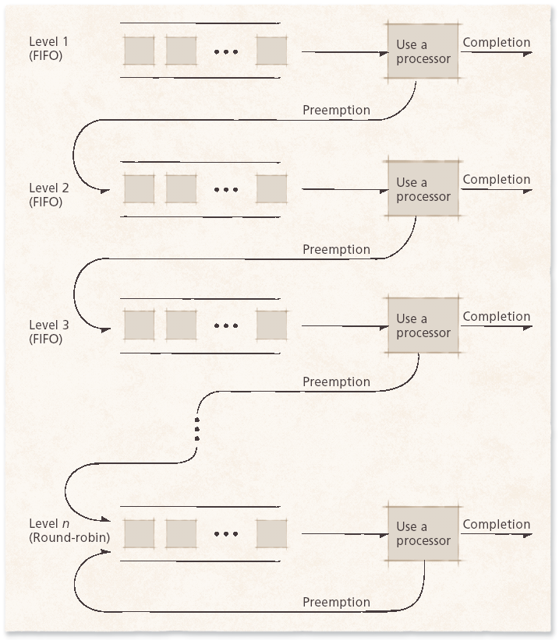
Multilevel Feedback Queues

Slide 48
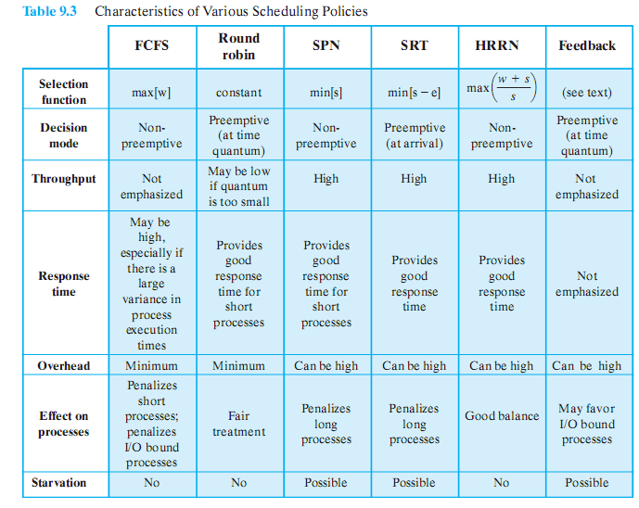

Slide 49
Guaranteed Scheduling:
System keeps track of how much CPU time each process has had since its creation. It computes the amount of CPU time each is entitled to (time since creation divided by n) and then computes the ratio of actual CPU time consumed to CPU time entitled and run the process with the lowest ratio until its ratio passes its closest competitor.
Lottery Scheduling:
Processes are given “lottery tickets” for system resources such as CPU time. When scheduling decision needs to be made, lottery ticket is chosen at random and the process holding that ticket gets the resource.

Slide 50
Fair Share Scheduling
Some systems schedule processes based on usage allocated to each user, independent of the number of processes that user has.
FSS controls users’ access to system resources
Some user groups more important than others
Ensures that less important groups cannot monopolize resources
Unused resources distributed according to the proportion of resources each group has been allocated
Groups not meeting resource-utilization goals get higher priority

Slide 51
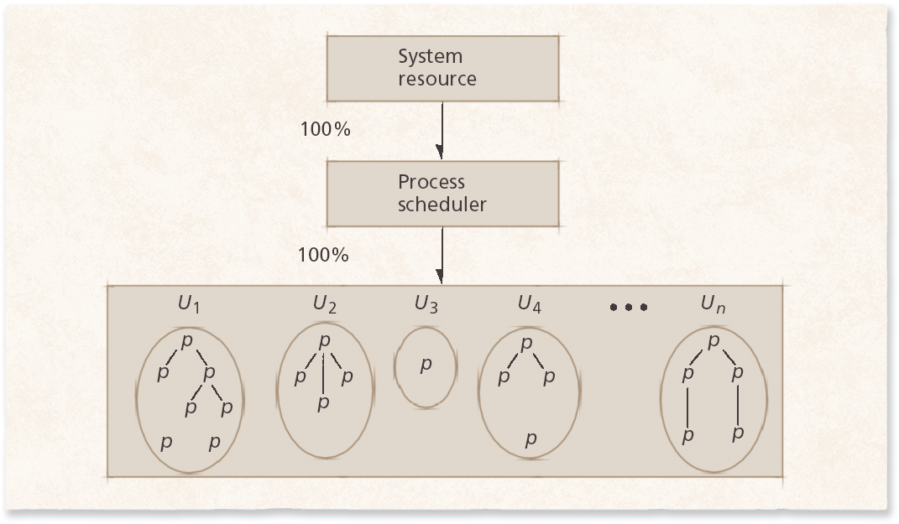
Fair Share Scheduling
Standard UNIX process scheduler. The scheduler grants the processor to users, each of whom may have many processes.

Slide 52
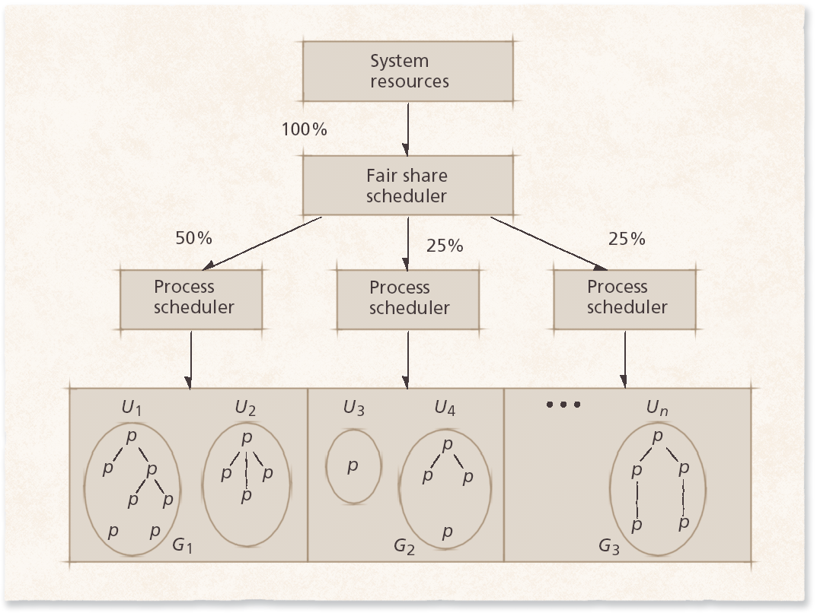
Fair Share Scheduling
Fair share scheduler. The fair share scheduler divides system resource
capacity into portions, which are then allocated by process schedulers assigned to
various fair share groups.

Slide 53
Deadline Scheduling
Deadline scheduling
Process must complete by specific time
Used when results would be useless if not delivered on-time
Difficult to implement
Must plan resource requirements in advance
Incurs significant overhead
Service provided to other processes can degrade

Slide 54
Real-Time Scheduling
Real-time scheduling
Related to deadline scheduling
Processes have timing constraints
Also encompasses tasks that execute periodically
Two categories
Soft real-time scheduling
Does not guarantee that timing constraints will be met
For example, multimedia playback
Hard real-time scheduling
Timing constraints will always be met
Failure to meet deadline might have catastrophic results
For example, air traffic control

Slide 55
Real-Time Scheduling
Static real-time scheduling
Does not adjust priorities over time
Low overhead
Suitable for systems where conditions rarely change
Hard real-time schedulers
Rate-monotonic (RM) scheduling
Process priority increases monotonically with the frequency with which it must execute
Deadline RM scheduling
Useful for a process that has a deadline that is not equal to its period

Slide 56
Real-Time Scheduling
Dynamic real-time scheduling
Adjusts priorities in response to changing conditions
Can incur significant overhead, but must ensure that the overhead does not result in increased missed deadlines
Priorities are usually based on processes’ deadlines
Earliest-deadline-first (EDF)
Preemptive, always dispatch the process with the earliest deadline
Minimum-laxity-first
Similar to EDF, but bases priority on laxity, which is based on the process’s deadline and its remaining run-time-to-completion

